Slide 1

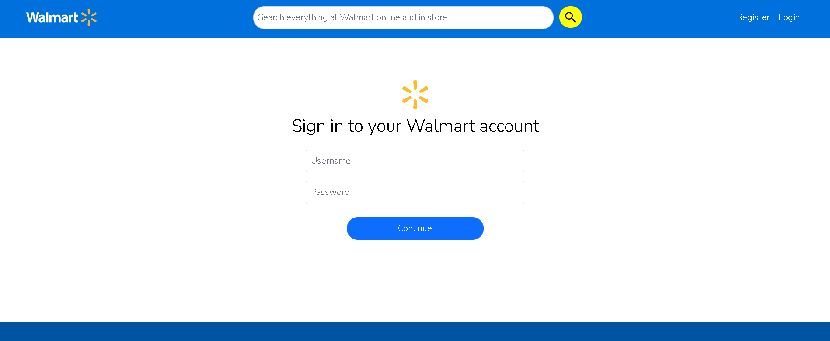
Walmart App
Team Bytecode Blasters
1.Boomika Muralikrishna
2.Sumit Shubham
3.Sneha Koli
4.Sai Manoj
5.K Sai Mahathi
Mentor: B V Sagar

Slide 2
WHY? WHAT? WHERE? HOW?

Slide 3
Agenda
Problem Statement
Objective
Microservices
Project Overview
Onboarding-Architecture
Project Flow
Technology and Tools Used
Snapshots
Conclusion

Slide 4
Problem Statement
X stuck in some work and he/she must submit it the next day. At the same time he/she gets a call from his/her mother to get some items, at this peak time X cant leave the office and go for shopping.

Slide 5
Objective
The objective of this app is to provide best user experience to X .
X will be able to Register, Login, Update his/her profile & Logout.
X will be able to search the products and add to wishlist.
X can add/delete products to/from Wishlist in X’s account
X will be able know about the stock of products.

Slide 6
Microservices
Authentication API
(Users Login)
WishList API
(Wishlist)
External API Service
(Rapid API)

Slide 7
Project Overview

Slide 8
Project Overview
Authentication API
WishList API
External API Service
Login
Authentication API
Favorite API
External API Service
Product Display
Home
WishList
Search
Register
External API
MySQL
MongoDB
Rapid API

Slide 9
Onboarding Architecture

Slide 10
Architecture
Authentication API
JWT validator
POST/GET/
PUT/DELETE request
MySQL
Login/Register
Token generated
Front End
Angular
Search
Get Available products
RapidApi.org
GET
WishList
Get Wishlist products
Post Wishlist products
Delete Wishlist products
POST /GET/
PUT/
DELETE
MongoDB Server
POST /GET/
PUT/
DELETE

Slide 11
Class Diagrams

Slide 12
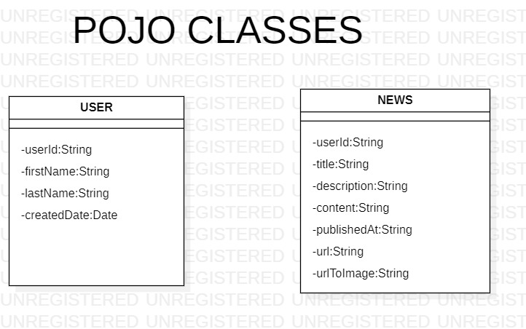
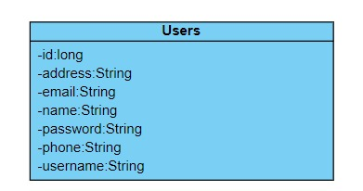
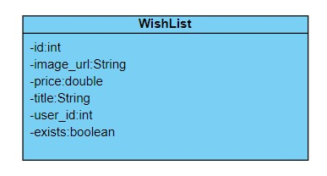

Slide 13
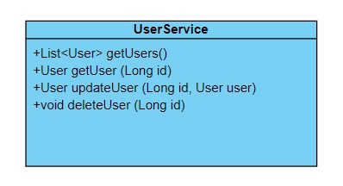
SERVICE INTERFACES

Slide 14
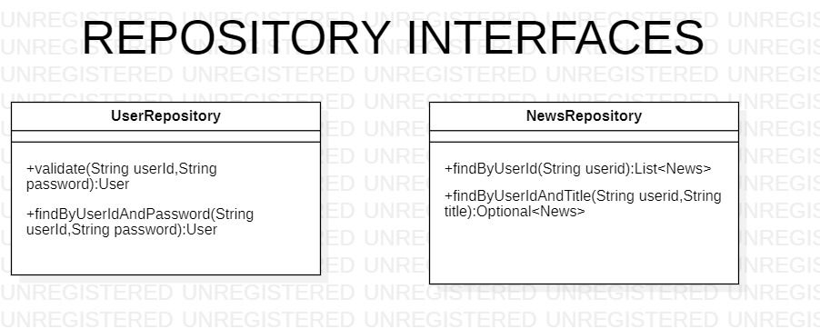
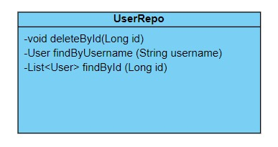
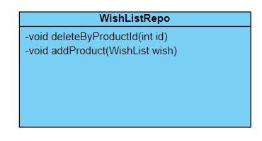

Slide 15
Project Flow

Slide 16
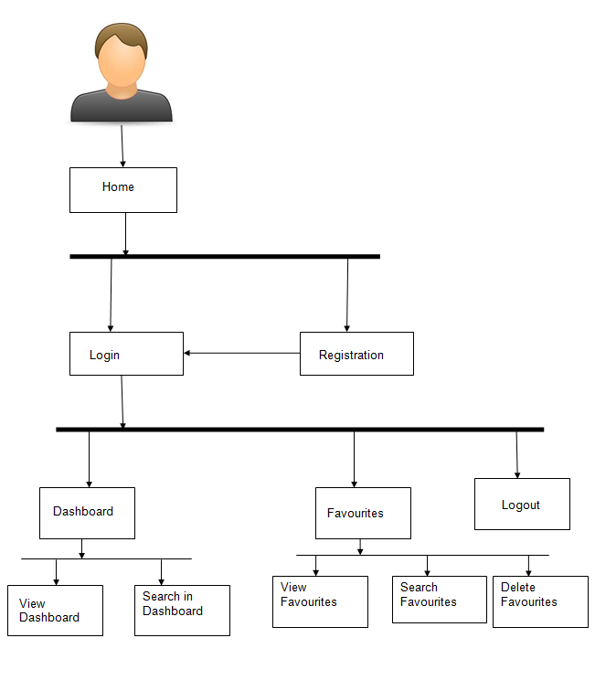
Project Flow
Home
Login
Register
Search product
Product List
WishList
Search product
Recommends
Add product to Wishlist
Increase the quantity of a product in wishlist
View Wishlist
Delete product from Wishlist
Search Books

Slide 17








Technologies and Tools Used

Slide 18
Snapshots

Slide 19
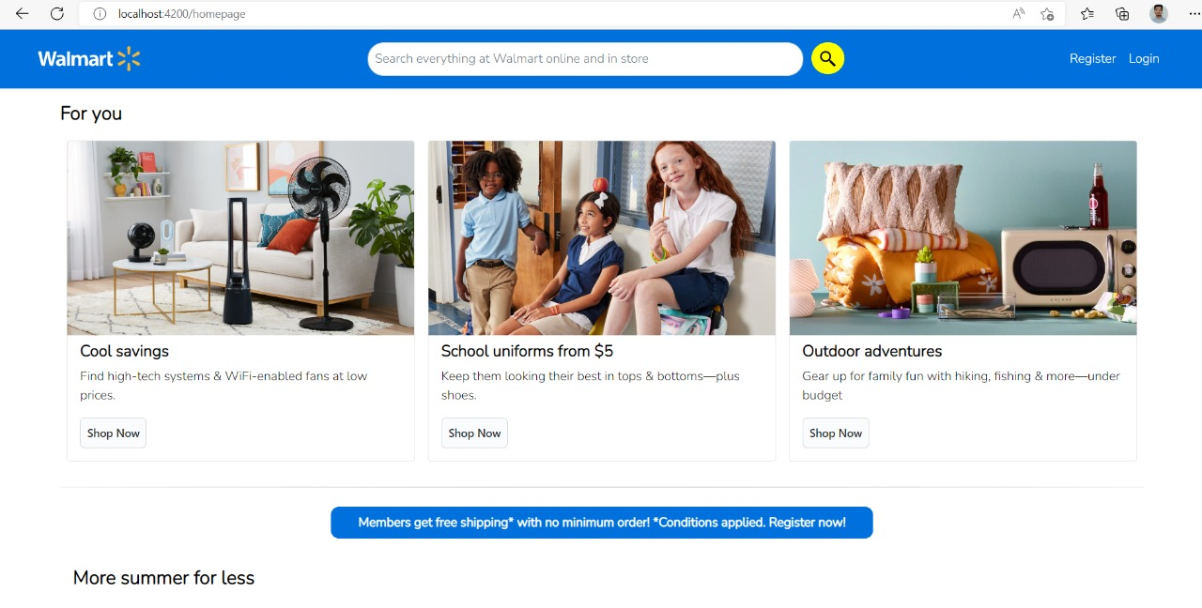

Slide 20
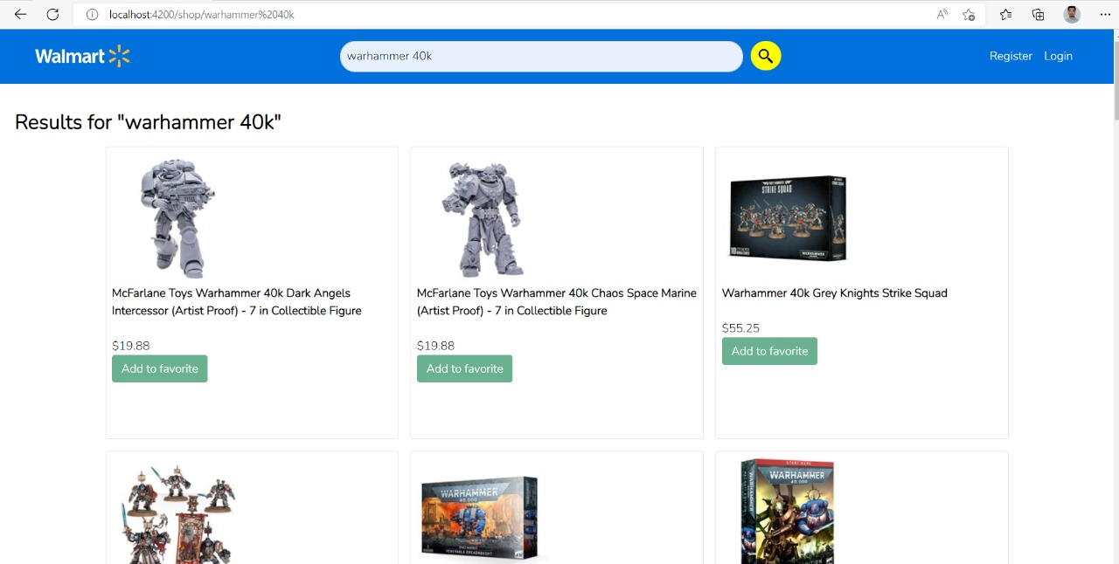

Slide 22
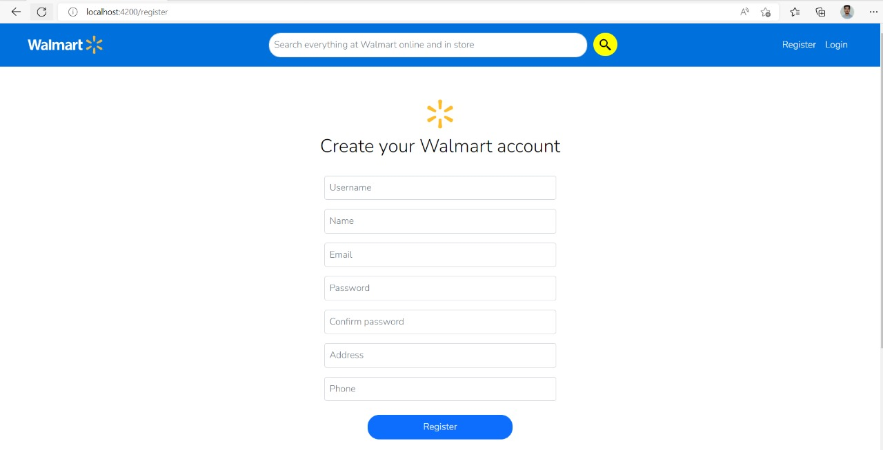

Slide 23
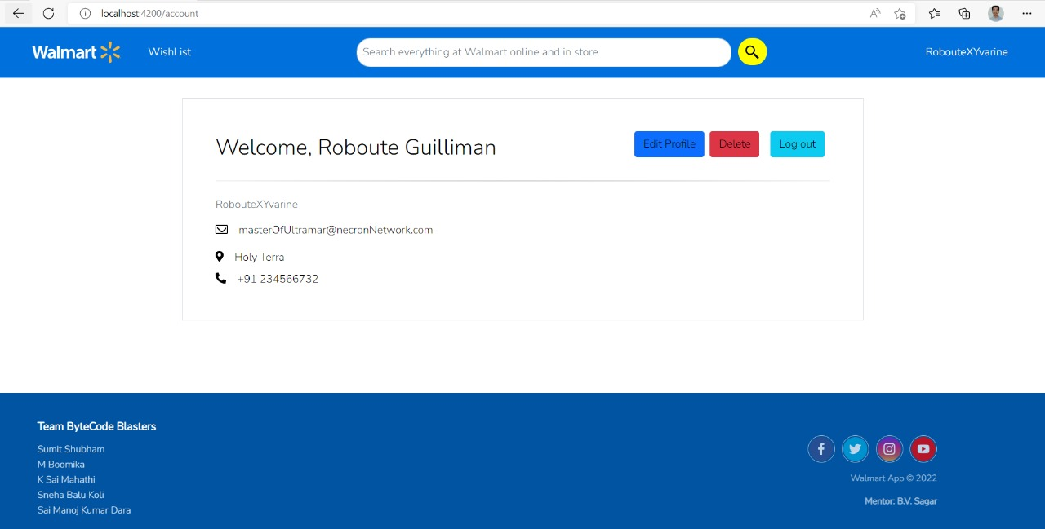

Slide 24
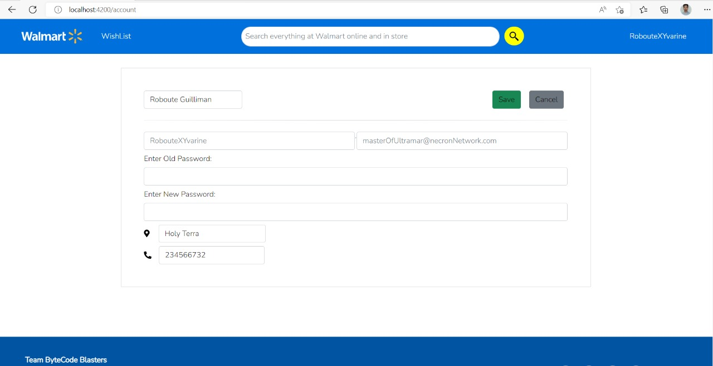

Slide 25
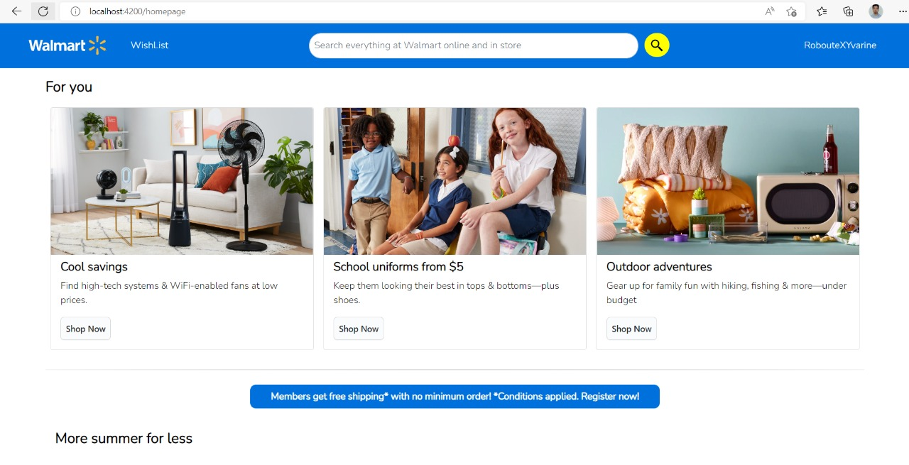

Slide 26
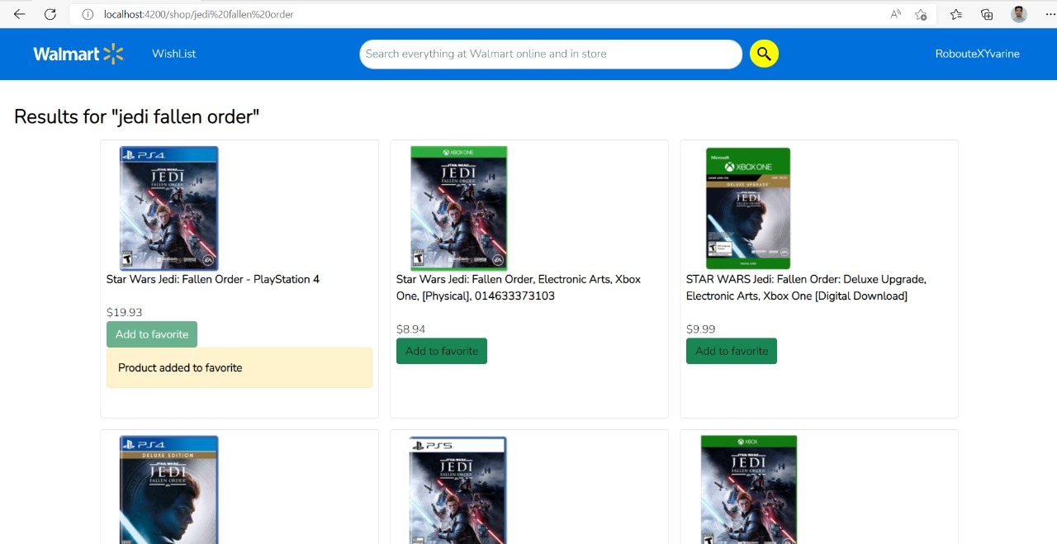

Slide 27
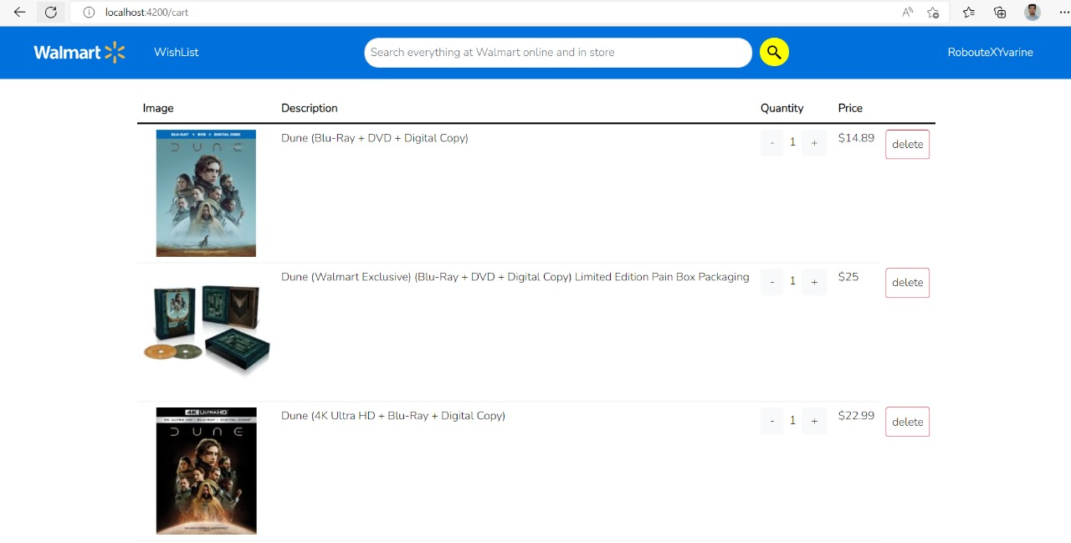

Slide 28
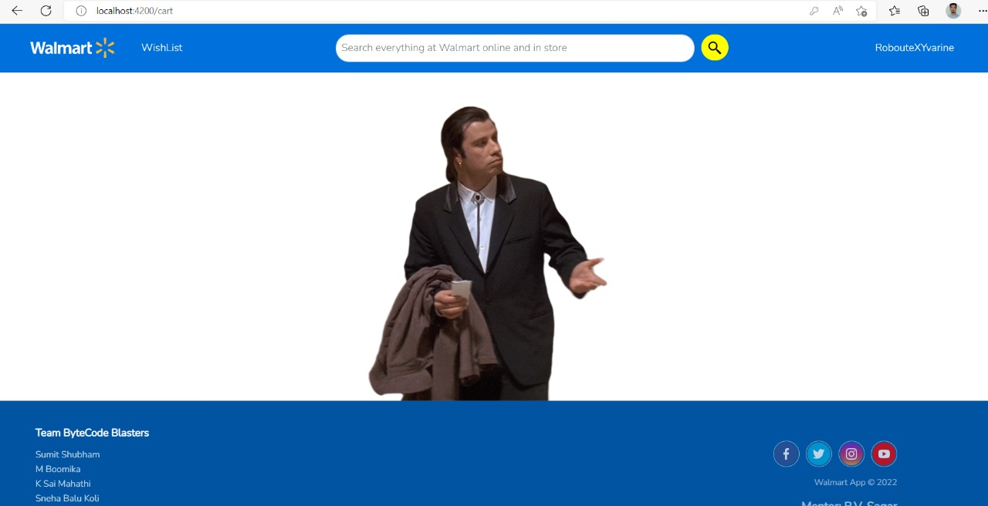

Slide 29
Conclusion
Walmart App helps the users to view and get the new updates of various products .
This app allows the user to Register, View, Add, Delete the products from/to wishlist.
The app also allows the user to increment the quantity of products in wishlist.
It auto updates the total amount of the particular product in the wishlist according to the quantity chosen.

Slide 30
Thank You

Slide 31


